Slide 1

Predicting Marketing Campaign Response Using EDA, PCA and Gradient-Descent-Based Logistic Regression
Summer Internship- 2026
Name: Akansha Duhoon
Supervisor: Prof. Millie Pant
Mentor: : Ms. Riya & Mr. Harjeet Applied Mathematics & Scientific Computing
Indian Institute of Technology Roorkee

Slide 2

Contents
1. Introduction 2. Objectives 3. Dataset Overview 4. Dataset & EDA 5. Data Preprocessing 6. PCA 7. Gradient Descent 8. Results & Conclusion
1

Slide 3
Introduction
Marketing teams run costly campaigns, but only a fraction of customers respond — identifying likely responders in advance improves ROI and cuts wasted spend.
This project analyzes a customer marketing dataset covering demographics, spending habits, purchase channels, and past campaign responses.
Goal: build an end-to-end pipeline — from raw data to a working predictive model — combining exploratory analysis, dimensionality reduction, and classification.
Scope: EDA & preprocessing, PCA, Logistic Regression classification, and a from-scratch study of Gradient Descent optimizers.
2,240
customer records
29
raw attributes
2

Slide 4
Objectives
Explore and understand the dataset through descriptive statistics and visualizations.
Clean and preprocess the data: handle missing values, encode categorical features, and scale numeric features.
Detect and treat outliers to improve overall data quality.
Apply Principal Component Analysis (PCA) for dimensionality reduction and visualization.
Train a Logistic Regression model to predict campaign Response.
Implement Batch, Stochastic, and Mini-Batch Gradient Descent from scratch and compare their convergence behaviour.
3

Slide 5
Dataset Overview
Raw data: 2,240 rows × 29 columns spanning demographics, income, product spend, purchase channels, and campaign-acceptance flags.
Data types: 25 integer columns, 1 float column (Income), and 3 categorical/date columns (Education, Marital_Status, Dt_Customer) — a mostly numeric dataset.
Only Income has missing values (24 records, ~1% of the data); every other column is fully populated.
Income averages ~₹52,247 (median ₹51,382), ranging from ₹1,730 to an outlier max of ₹666,666 — motivating the outlier-treatment step later in preprocessing.
2,240
customer records
24
missing values (Income only)
4

Slide 6
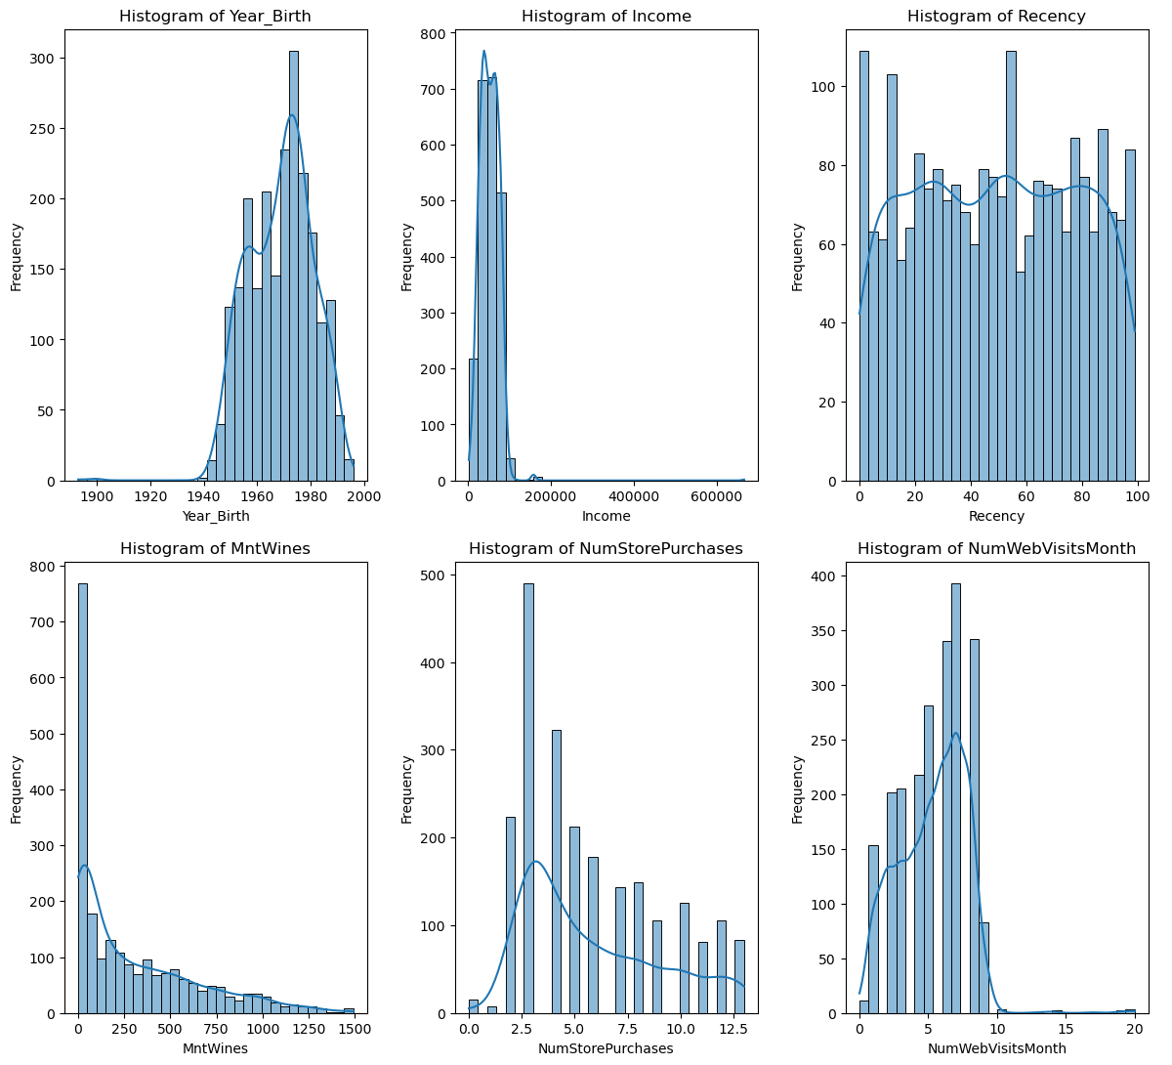
Distributions of key numeric features (Year of Birth, Income, Recency, Wine Spend, Store & Web Visits)
5

Slide 7
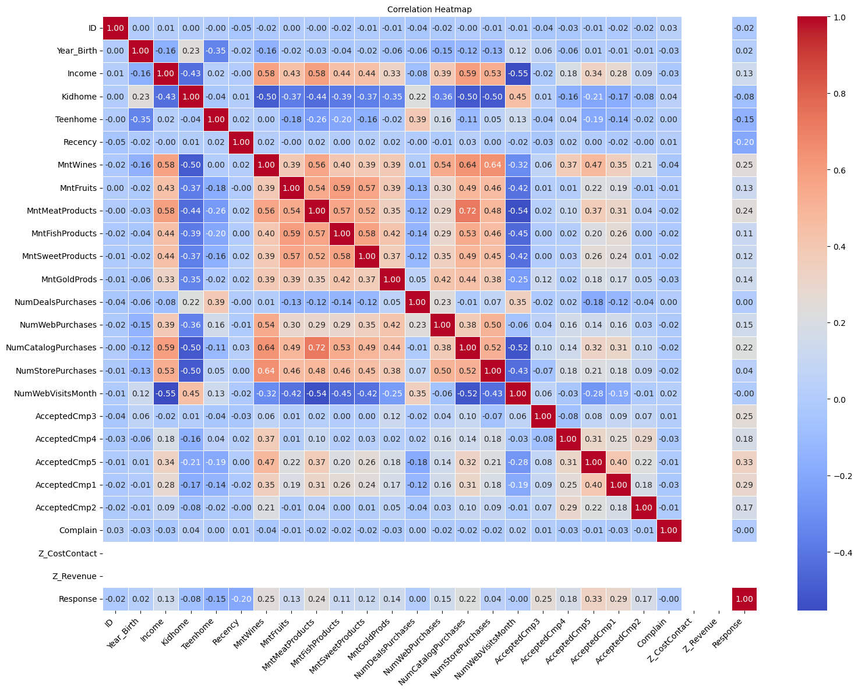
Dataset & Exploratory Data Analysis
2,240 customer records with 29 attributes: demographics, spend across product categories, purchase channels, and campaign-acceptance history.
Income had 24 missing values; distributions were reviewed using histograms and boxplots across all numerical columns.
A correlation heatmap reveals moderate positive relationships among purchase-related variables (wine and meat spend, store and web purchases), while most other features show weak correlation.
Pair plots of top features helped visualize relationships between income and spending behaviour.
6

Slide 8
Data Preprocessing
Missing Income values imputed with the median; missing categorical values imputed with the mode.
Education and Marital_Status one-hot encoded.
Numeric features standardized (StandardScaler); MinMaxScaler compared for reference.
Outliers removed using a Z-score threshold (|z| < 3): dataset reduced from 2,240 to 1,592 records.
Dt_Customer converted into a new engineered feature, Customer_Tenure_Days.
Data split into training (1,273) and test (319) sets — an 80/20 split.
7

Slide 9
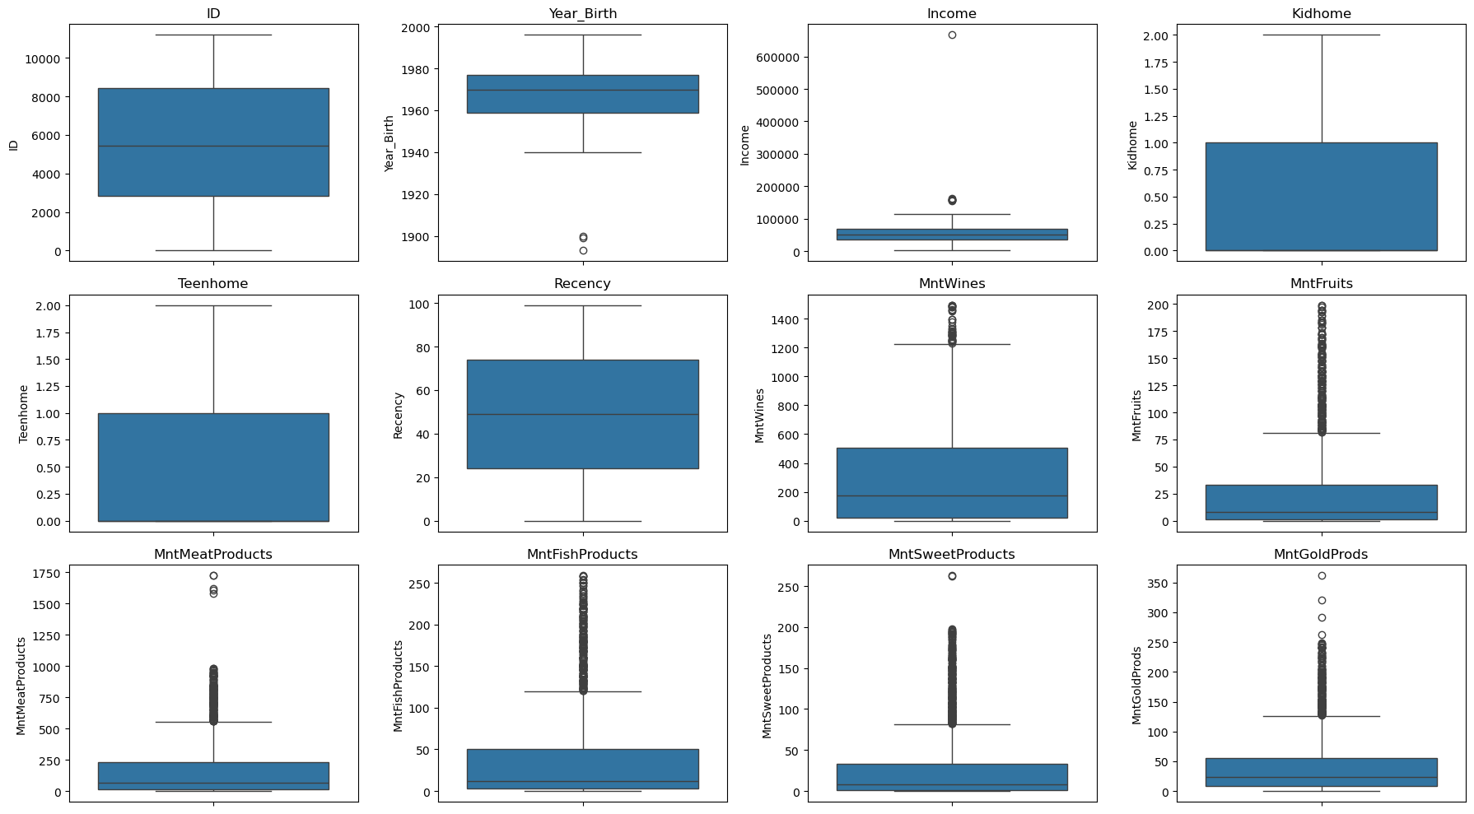
Outlier detection across numerical features (IQR / boxplots)
8

Slide 10
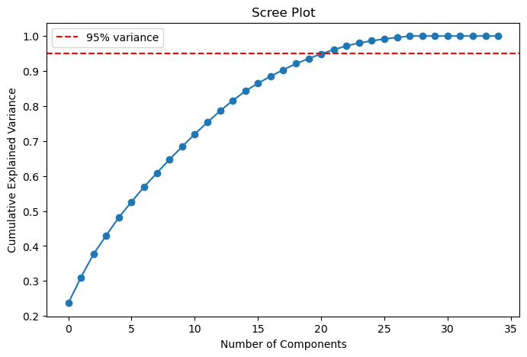
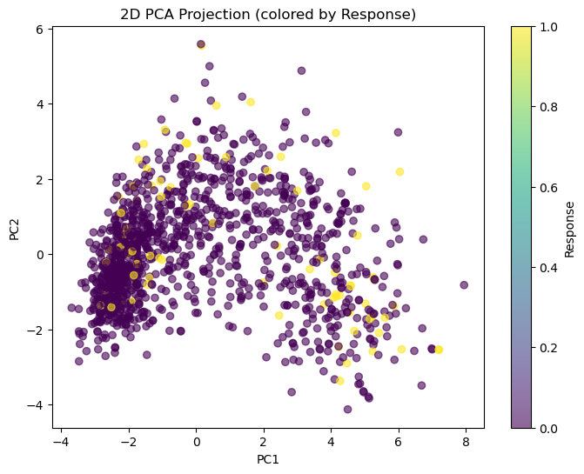
Dimensionality Reduction with PCA
Standardized features (35 dimensions after encoding) were fed into PCA.
The scree plot shows 22 components are needed to retain 95% of the variance — roughly a 37% reduction in dimensionality.
A 2D projection of the first two components visualizes separation between responders and non-responders.
A loadings heatmap highlights which original features contribute most to each principal component.
9

Slide 11
Predictive Modeling — Logistic Regression
Logistic Regression was trained twice: once on all 35 scaled features, and once on the 22 PCA components.
PCA cut the feature space by ~37% with only a 0.3 percentage-point drop in accuracy — a strong trade-off for a simpler, faster model.
91.2%
Accuracy — original 35 features
90.9%
Accuracy — 22 PCA components
10

Slide 12
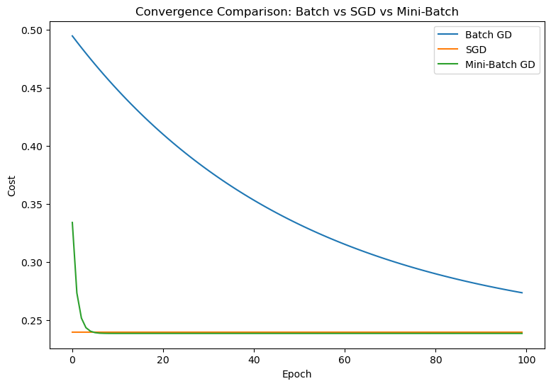
Gradient Descent Optimization — From Scratch
Implemented Batch, Stochastic (SGD), and Mini-Batch Gradient Descent from scratch to fit a simple linear model (Income → MntWines).
Batch GD is smooth but makes slower per-epoch progress; SGD is noisier but often converges faster in wall-clock time; Mini-Batch balances both.
Also studied the effect of learning rate and batch size on convergence stability.
The custom SGD implementation closely matched scikit-learn's SGDRegressor coefficients, validating the from-scratch code.
11

Slide 13
Results Summary
Logistic Regression predicted campaign Response with ~91% accuracy on a held-out test set, whether trained on all 35 scaled features or the 22 PCA components.
The from-scratch Batch, SGD, and Mini-Batch Gradient Descent implementations converged to coefficients closely matching scikit-learn's SGDRegressor (0.71 vs. 0.46–0.72), confirming the custom code is correct.
91.2%
Peak test accuracy (Logistic Regression)
22 / 35
Features retained by PCA (95% variance)
12

Slide 14
Conclusion
This project delivered a complete pipeline — from raw customer data to a validated predictive model — showing that EDA, preprocessing, PCA, and Logistic Regression combine effectively for campaign-response prediction.
Dimensionality reduction via PCA proved a strong trade-off: a ~37% smaller feature space cost almost no accuracy, making the model faster and simpler to maintain.
The from-scratch Gradient Descent study confirmed Mini-Batch GD's balance of speed and stability — reinforcing why it is the default in most production ML libraries.
Limitations: the response class is imbalanced and results rest on a single train/test split — cross-validation and class-balancing (e.g. SMOTE) would strengthen the evaluation.
Future work: try ensemble models (Random Forest, XGBoost), add customer segmentation via clustering, and deploy the pipeline as a real-time campaign-targeting tool.
13

Slide 15
References
Dataset: “Customer Personality Analysis / Marketing Campaign Data”, Kaggle.
Pedregosa, F. et al. “Scikit-learn: Machine Learning in Python.” Journal of Machine Learning Research, 2011.
Hunter, J. D. “Matplotlib: A 2D Graphics Environment.” Computing in Science & Engineering, 2007.
Waskom, M. “seaborn: Statistical Data Visualization.” Journal of Open Source Software, 2021.
McKinney, W. “Data Structures for Statistical Computing in Python.” Proc. of the 9th Python in Science Conf., 2010.
Jolliffe, I. T. “Principal Component Analysis.” Springer Series in Statistics, 2002.

